Slide 1

Generative Adversarial Networks
aCubeIT
L03 - Deep Learning for Life Sciences Course

Slide 2
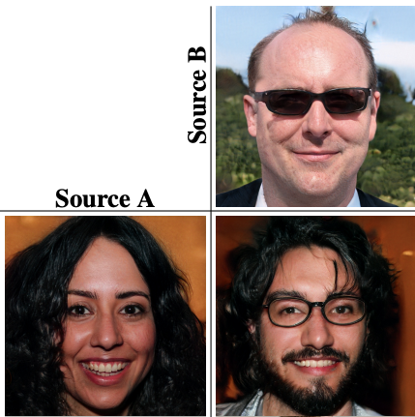
Generative Adversarial Networks (GANs)
Creating content

Slide 3


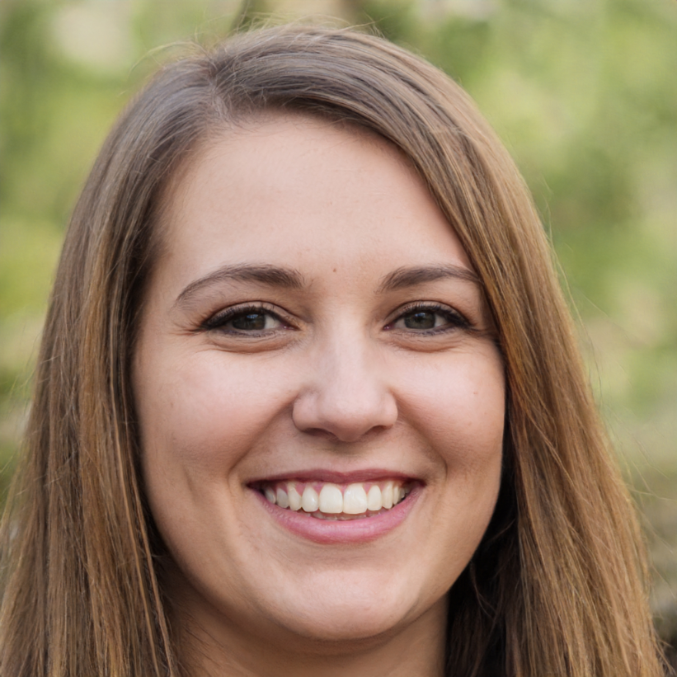
Which face is fake ?
Karras et al., 2019. Analyzing and improving the image quality of stylegan.

Slide 4

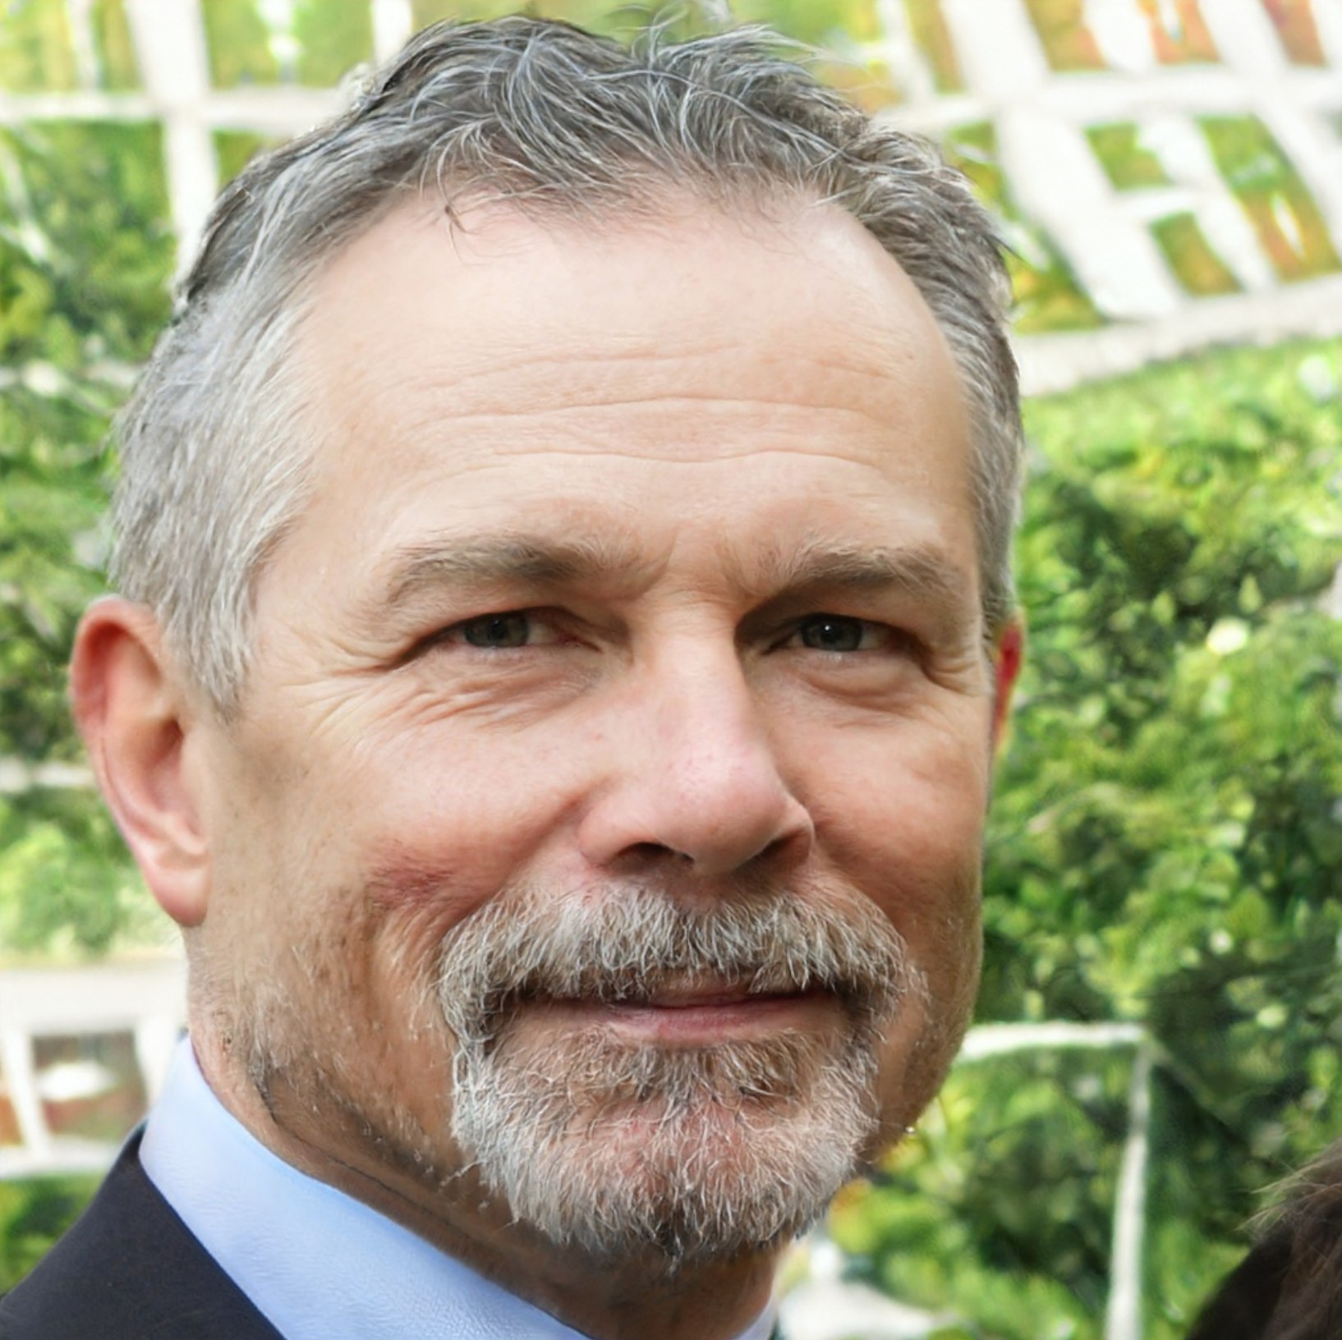
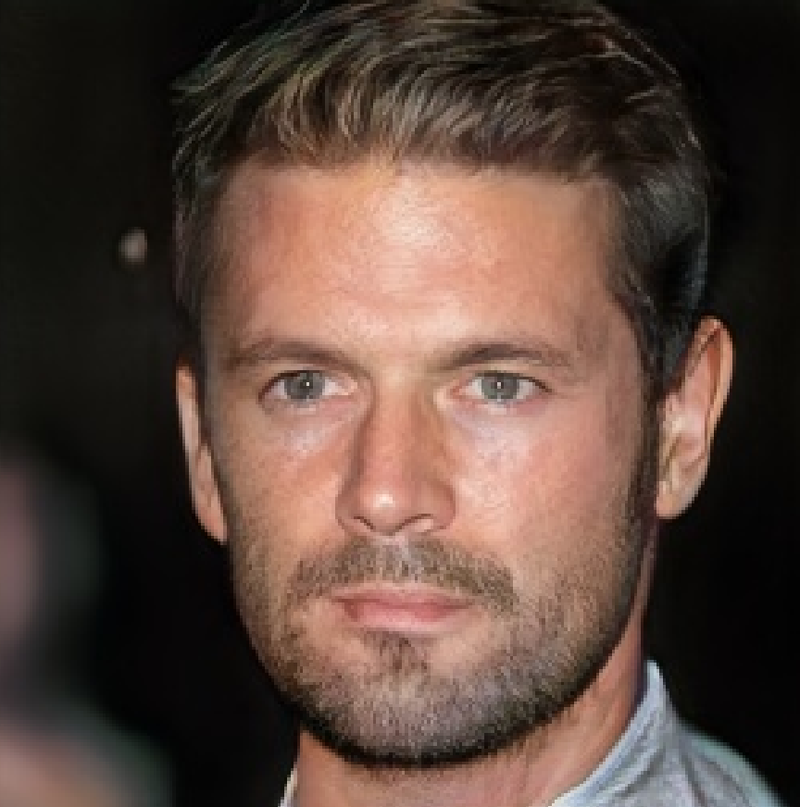
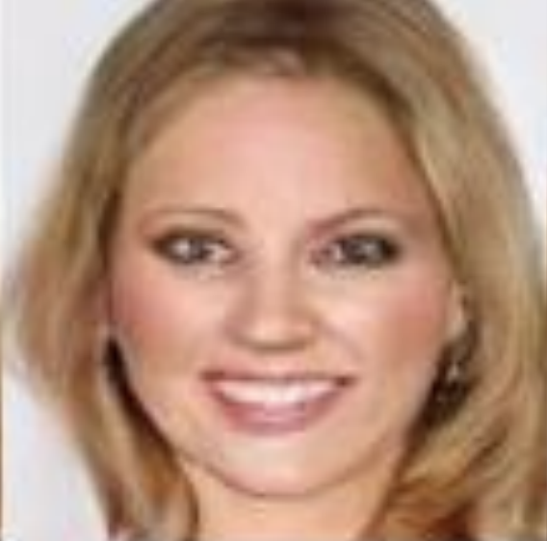
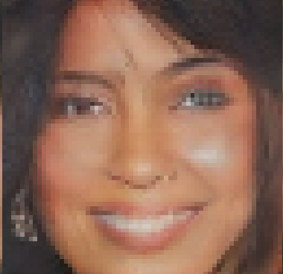
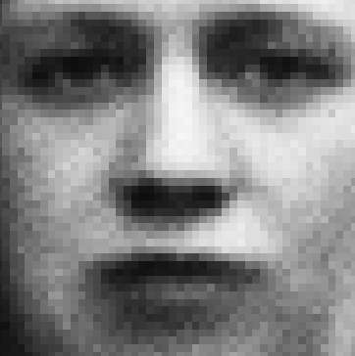
Generative Adversarial Networks (GANs)
2014
2015
2016
2017
2018
2019
Generative modelling → progress in facial image generation
Newer and more sophisticated methods every year

Slide 5
Supervised Learning
1 | ... | ...
2 | ... | ...
3 | ... | ...
…
…
…
…
…
…
So far we’ve seen models which:
Take an input
Produce an output
Optimised with a loss-function
Training Data
Labels
Predictions

Slide 6
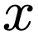
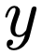
Supervised Learning
Input
So far we’ve seen models which:
Take an input
Produce an output
Optimised with a loss-function
Output
Encode

Slide 7
Unsupervised Learning
Generative models are different.
Instead of taking a sample as input, they produce a sample as output.

Slide 8
Unsupervised Learning
Train model on photographs of cats
Learn to produce new cat-like images
Train it on known drug molecules
Generate new ‘drug-like’ molecules to use as candidates in a virtual screen.
A generative model is trained on samples which are drawn from a:
probability distribution
Its job is to produce new samples from that same probability distribution.

Slide 9
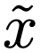
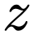
Auto-Encoder
Input
Output
Latent Space
Encode
Decode

Slide 10
Auto-Encoder
Encoder: samples → compressed representations
Decoder: compressed representations in latent space → original samples
What if we take random vectors in the latent space (picking a random value for each component of the vector) and pass them through the decoder ?
If everything goes well, the decoder should produce a completely new sample that resembles the ones it was trained on.

Slide 11
Auto-Encoder
Problem ?
Doesn't work very well.
Encoder may only produce vectors in a small region of the latent space.
But if we pick a vector from outside that region ?
Output could look nothing like the training samples
Decoder has only learned to work for the particular latent vectors from encoder
Not for arbitrary ones.

Slide 12
Variational Auto-Encoder (VAE)
Solution ?
Variational Auto-Encoder
Add a term to the loss function that forces the latent vectors to follow a specified distribution, eg N ∼ (0, 1)
We can expect the decoder to work well on them
We add random noise to the latent vector
Prevents decoder from being too sensitive to details

Slide 13
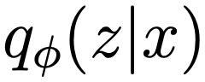
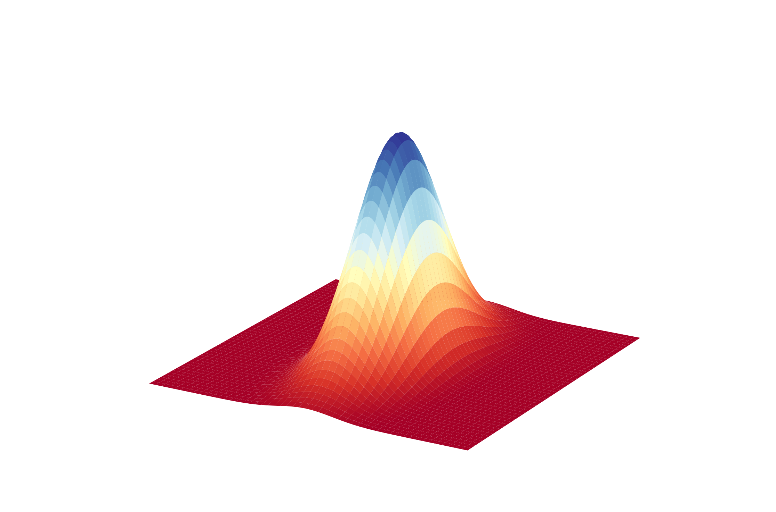
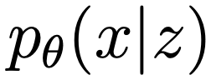
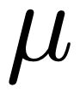
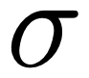
Variational Auto-Encoder (VAE)
Input
Latent Space
Output
Original
Image
Reconstructed
Image
Encode
Decode

Slide 14
Simplified VAE Representation
Input
Latent Space
Output
Original
Image
Reconstructed
Image
Encode
Decode

Slide 15
Encoder-Decoder
Encode
An encoder is just a convolutional operation coupled with an activation function
A decoder is de-convolutional operation and activation function
De-conv2D is just a transposed Conv2D
Decode
Conv2D
Deconv2D
ReLU
ReLU

Slide 16
Encoder-Decoder
Encode
Decode
# Encoder
tf.nn.conv2d()
tf.nn.relu()
# Decoder
tf.nn.conv2d_transpose()
tf.nn.relu()
Conv2D
Deconv2D
ReLU
ReLU

Slide 17
Latent Distribution
The latent vector z ∼ (μ, σ)
Compressed representation of input x
q_Φ(z|x) encodes x to z
p_θ(x|z) decodes z to x
θ and Φ represent weights and biases
Remember: we sample from the distribution z → lossy reconstruction

Slide 18
VAE Applications
Colorize B&W images
Encoder-Decoder architecture
Inception ResNet V2 Classifier
Emil Wallner, 2017. Colorizing B&W Photos with Neural Networks. FloydHub.

Slide 19
Generative Adversarial Network
Works similarly to VAEs
Uses encoder-decoder system
Converts latent vectors into samples
‘Generator’ instead of decoder
But trains in a different way:
Passes random vectors into the generator
Directly evaluates the outputs on how well they follow the expected distribution

Slide 20
Generative Adversarial Network
Essentially create a loss function to measure:
How well generated samples match the training samples
Use that loss function to optimise the model
How to make such a loss-function ?
You don’t.
GAN learns the loss function from the data.

Slide 21
Generative Adversarial Network
Latent Space
Input - Output
Probability
Generator
Discriminator

Slide 22
Generative Adversarial Network
Generator: takes random vectors → generates synthetic samples
Discriminator: tries to distinguish between
The generated samples from real training samples
It takes a sample as input and outputs a probability of being a real sample
This acts as a loss function for the generator.

Slide 23
Generative Adversarial Network
Samples
Latent Space
Discriminator
Generator
+
Random Noise
Update

Slide 24
Generative Adversarial Network
Generator and discriminator are run simultaneously.
Generator tries to ‘fool’ discriminator by presenting realistic samples
Discriminator tries to get better at distinguishing real from fake samples
Generative Adversarial Networks

Slide 25
GAN Applications
Colorize B&W images
Even more advanced and realistic
GAN based architecture
Jason Antic, 2018. DeOldify: Colorizing and Restoring Old Images and Videos with Deep Learning. FloydHub.

Slide 26
VAE vs GANs
Roughly:
GANs tend to produce higher-quality samples
VAEs tend to produce higher-quality distributions
Individual samples generated by GANs more closely resemble training samples
Range of samples generated by VAE more closely match range of training samples
Very active field of research → Things changing constantly !

Slide 27
Application: Predicting Drug-Target Binding Affinity
Challenging in Drug Discovery
Supervised-learning based methods require labeled data on large scale
Expensive
Difficult
97M compounds reported by the PubChem database
12K drug entries reported by the DrugBank are considered
Semi-supervised GAN based methods can help ¹
¹ Zhao Lingling et al., 2020. GANsDTA: Predicting Drug-Target Binding Affinity Using GANs. Frontiers in Genetics, Volume 10.

Slide 28
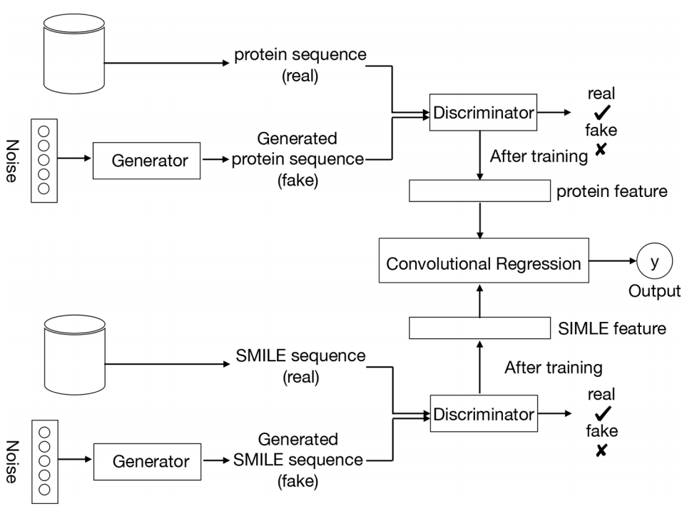
Application: Predicting Drug-Target Binding Affinity
Train the GANs on the unlabelled data set
Compound SMILES and protein sequences are encoded
Two independent GANs are applied
Generate the fake samples
Use GANs’ trained discriminator
Project labeled datasets into a feature latent space
Train a convolutional regression based on this feature
Predict the DT binding affinity

Slide 29
Application: Predicting Drug-Target Binding Affinity
Pipeline:

Slide 30
Future Work
Remember the progress !
Next: generative videos
High-res embryonic development ?
Deepfakes ?
Evolving quickly
2014
2015
2016
2017
2018
2019

Slide 31
Thank you !
Ackruti Trade Center, MIDC, Mumbai, IND
www.acubeit.com
+91 9892512129
prakash@acubeit.com
aCubeIT

